Slide 1
Chapter 14
Decision Analysis - Part I
Athena Alimirzaei
Operations Management Area
Jindal School of Management

Slide 2
1. Introduction
Decision-making: A process of selecting the best course of action.
Key to making sound decisions: Use of systematic, rational approaches to analyze relevant information rather than relying on intuition, hunch, etc.
Glossary:
  Action - An alternative available to a decision-maker.
  State of nature - Outcome over which the decision maker has no control.
  Payoff - Result from taking an action under a state of nature.
  Payoff matrix - A table summarizing finite number of alternatives, states of nature, and the corresponding payoffs.
2

Slide 3
1. Introduction
Glossary (cont’d)
  Expected payoff (EP) - The average payoff ffrom taking an action (i.e., making a decision) under various states of nature, which is determined by multiplying each payoff by the probability of the corresponding state of nature and then summing the results.
  Sample information - The partial information that results from a sampling study of the decision problem.
  Perfect information - The complete information that indicates which state of nature will occur with certainty.
Remark: In this chapter, we consider taking an action to be the same as making a decision, i.e., taking an action = making a decision.

Slide 4




Introduction
Example - Traveling from Dallas to Houston
  Actions (decisions): Fly, drive
  States of nature: Good weather, bad weather
  Payoffs: Good-fly, 1 hour; good-drive, 4.5 hours;
  bad-fly, 1.2 hours; bad-drive, 5 hours
  Payoff matrix
Good Bad
Fly 1 4.5
Drive 1.2 5
Notes:
Today, auctions have been used to conduct a huge volume of transactions, such as the sale of houses, cars, private collection and government project. Auctions have experienced exponential growth in terms of sales volume, revenue, and product categories. In addition, New auctions continue to be designed and implemented.

Slide 5
1. Introduction
Classification of decision-making environments:
  (1) Decision-making under certainty (DMUC) - Two or more states of nature exist, and it is known which of them will occur for sure.
  (2) Decision-making under uncertainty (DMUU) - Two or more states of nature exist, and it is unknown which of them will occur.
  ● Non-probabilistic case: Decision-maker is unable to assign probabilities of occurrences to states of nature.
  ● Probabilistic case: Decision-maker is able to assign probabilities of occurrences to states of nature.

Slide 6

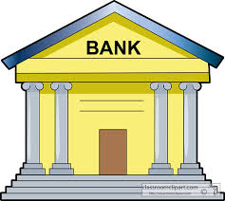
2. Decision-making Under Certainty (DMUC)
If it is known which state of nature will occur with certainty, one simply makes the optimal decision by selecting the alternative leading to the best payoff under that particular state of nature.
Example 14.1: Allen must decide whether to invest $10,000 in the stock market or in a six-month certificate of deposit at an interest rate of 8.5 percent. If he invests in the stock market and the market is good, he gets a 14% return on his money. If the market is fair, he gets an 8% return. If the market is bad, he gets no return at all.
(1) Identify the (a) actions (or decisions), (b) states of
nature, and (c) payoffs in the decision problem.
(2) Set up a payoff matrix for the problem.
(3) If the stock market will be fair with certainty, what
should Allen do?
Notes:
In the existing auction literature, there are four types of auctions.
The first type is ascending-bid auction. In ascending-bid auction, the auction starts at a relatively low price and continues to increase it until only one bidder remains. The English auction is the most commonly used ascending-bid auction. It is so named because it is traditionally used by leading English auction houses, such as, Sotheby’s and Christie’s.
The second type is descending-bid auction, which is the opposite of the ascending-bid auction in that the auctioneer starts with a high price and continues to lower it till one bidder shows his willingness to pay. Dutch auction is the most commonly used descending auction.
The third type is sealed-bid first-price auction. Under this auction type, the bidding information is confidential to other bidders, only the auctioneer has access to it. The highest bidder is the winner and pays what he actually bid.
However, in the last auction type, sealed-bid second-price auction, the information about other bids is unavailable. The highest bidder is still the winner, however, he pays the second highest bid.
This is the difference between sealed-bid first price auction and sealed-bid second price auction.

Slide 7
2. Decision-making Under Certainty (DMUC)
Example 14.1: (cont’d)
[Solution] (1) (a) Stock market (SM), certificate of deposit (CD).
(b) Good (G), fair (F), bad (B).
(c) 1,400 (= 10,000 x 14%), 800 (10,000 x 8%), 0 (= 10,000 x 0%), 850 (= 10,000 x 8.5%).
(2) G F B
SM 1,400 800 0
CD 850 850 850
(3) He should invest in the CD since 850 > 800 under the state of nature F.

Slide 8
3. DMUU - Non-probabilistic Case
Three criteria are widely used for making decisions under uncertainty when the decision-maker is unable to assign a probability of occurrence to each of the states of nature:
  (1) Maxi-min (pessimistic or Wald) - Taking the action leading to the best of the worst payoffs.
  (2) Maxi-max (optimistic) - Taking the action leading to the best of the best payoffs.
  (3) Mini-max regret - Deriving the regret matrix (or matrix of opportunity loss) and then taking the action leading to the smallest of the largest regrets

Slide 9
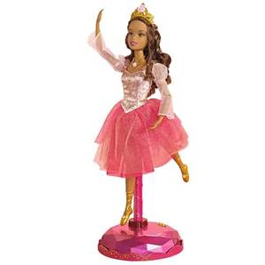
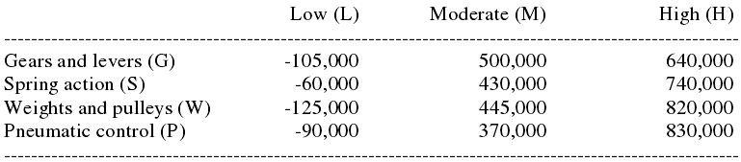
3. DMUU - Non-probabilistic Case
Example 14.2: A toy manufacturer in Beijing, China,
must choose one of four designs for a dancing doll:
G, S, W, P. Each design is based on a different
technology for the new toy, for which the demand is
uncertain but will be either low, or moderate, or high.
The payoff table is shown below:

Slide 10
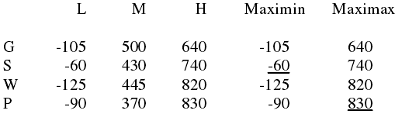
3. DMUU - Non-probabilistic Case
Example 14.2: (cont’d)
Determine the toy company’s best choice of design using each of the three criteria below: (1) maxi-min, (2) maxi-max, and (3) mini-max regret.
[Solution] In what follows, all the payoffs are in thousands of dollars:

Slide 11
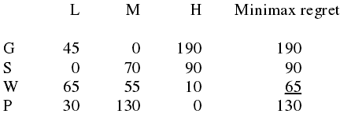
3. DMUU - Non-probabilistic Case
Example 14.2: (cont’d)
[Solution] (1) The company should choose S design since -60 > -90 > -105 > -125.
(2) The company should choose P design since 830 > 820 > 740 > 640.
(3) It is seen from the regret matrix below that the company should choose W design since 65 < 90 < 130 < 190.

Slide 12
4. DMUU - Probabilistic Case
Three criteria are available for making decisions under uncertainty when the decision-maker is able to assign a probability of occurrence to each of the states of nature:
  (1) Modal outcome (MO) - Taking the action leading to the best payoff under the state of nature with the highest probability of occurrence.
  (2) Expected value (EV) - Taking the action leading to the best expected payoff.
  (3) Expected regret (ER) - Taking the action leading to the smallest expected regret.

Slide 13
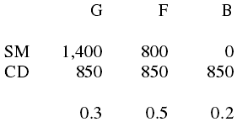
4. DMUU - Probabilistic Case
Example 14.3: Suppose that the probabilities of a good market, a fair market, and a bad market are 0.3, 0.5, and 0.2, respectively, in Example 14.1. What should Allen do based on each of the following criteria: (1) MO, (2) EV, and (3) ER?
[Solution] The payoff matrix along with probabilities of occurrence for the states of nature is shown below:

Slide 14
4. DMUU - Probabilistic Case
Example 14.3: (cont’d)
[Solution] (1) Since 0.5 > 0.3 > 0.2, the state of nature with the highest probability of occurrence is F. So Allen should invest in the CD because 850 > 800 under the state of nature F.
(2) SM: EV = 0.3(1,400) + 0.5(800) + 0.2(0) = 820
CD: EV = 0.3(850) + 0.5(850) + 0.2(850) = 850
Since 850 > 820, Allen should invest in the CD.
(3) The regret matrix along with the probabilities of occurrence for the states of nature is shown below:

Slide 15
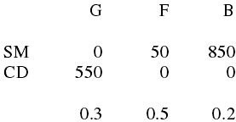
4. DMUU - Probabilistic Case
Example 14.3: (cont’d)
[Solution]
SM: ER = 0.3(0) + 0.5(50) + 0.2(850) = 195
CD: ER = 0.3(550) + 0.5(0) + 0.2(0) = 165
Since 165 < 195, Allen should invest in the CD.
Remark: The EV criterion and the ER criterion always lead to the same conclusion.

Slide 16
4. DMUU - Probabilistic Case
Expected value of perfect information (EVPI): It is an important concept in decision-making under uncertainty when the decision-maker is able to assign a probability of occurrence to each of the states of nature.
Importance of EVPI: It is the maximum amount of money that a decision maker is willing to pay for perfect information. EVPI can be found in two different ways:
(1) EVPI = | EP with perfect information - Best EP based on EV criterion |
(2) EVPI = Best ER
Example 14.4: Refer to Example 14.3. Suppose Allen is thinking of paying for a stock market newsletter, which always predicts accurately whether the market will be good, fair, or bad.

Slide 17
4. DMUU - Probabilistic Case
Example 14.4: (cont’d)
(1) What is the EVPI based on the first approach?
(2) What is the EVPI based on the second approach?
(3) Are the results in (1) and (2) above consistent?
(4) Should Allen pay for the newsletter if it will cost him $180?
[Solution] (1) The payoff matrix is reproduced below along with the probabilities of the states of nature:

Slide 18

4. DMUU - Probabilistic Case
Example 14.4: (cont’d)
[Solution]
The EP with perfect information is 0.3(1,400) + 0.5(850) + 0.2(850) = 1,015. In addition, as shown in the solutions to Part (2) of Example 4.3, the best EP based on the EV criterion is 850. It follows that EVPI = |1,015 - 850| = |165| = 165.
(2) According to the solutions to Part (3) of Example 14.3, the best ER is 165. So, EVPI = 165.

Slide 19
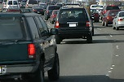
4. DMUU - Probabilistic Case
Example 14.4: (cont’d)
[Solution] (3) Yes, they are.
(4) Since EVPI = 165 < 180, Allen should not pay for the newsletter.
Example 14.5: Wendy has three routes to take to work
every day. She can take main street (M) the entire way,
she can take several back streets (B), or she can use the
expressway (E). Over the past several months, Wendy
has tried each route several times under different traffic
conditions. The travel time (in minutes) are summarized
in the following table:

Slide 20
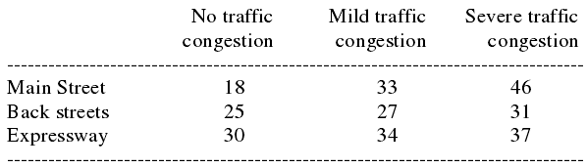
4. DMUU - Probabilistic Case
Example 14.5: (cont’d)
(1) Determine which route Wendy should take based on each of the following criteria: (a) maxi-min; (b) maxi-max.
(2) In the last 50 days, Wendy encountered no congestion (N) 20 days, mild congestion (M) 20 days, and severe congestion (S) 10 days. Assume that the last 50 days are typical of traffic conditions. Which route should she take based on the EV criterion?

Slide 21
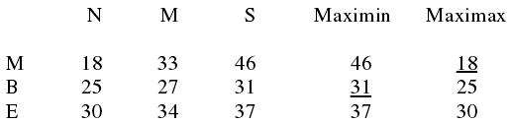

4. DMUU - Probabilistic Case
Example 14.5: (cont’d)
(3) Suppose Wendy is about to buy a radio for her car that would tell her the exact traffic conditions before she starts to work every morning. How much time can Wendy save, on the average, by purchasing the radio? (Hint: Use the concept of EVPI.)
[Solution] (1)
(a) Based on the maxi-min criterion, Wendy should take the back streets since 31 < 37 < 46.

Slide 22
4. DMUU - Probabilistic Case
Example 14.5: (cont’d)
[Solution] (b) Based on the maxi-max criterion, Wendy should take the main street since 18 < 25 <30.
(2) The probabilities of occurrence for N, M, and S are 20/50 = 0.4, 20/50 = 0.4, and 10/50 = 0.2, respectively.
M: EV = 0.4(18) + 0.4(33) + 0.2(46) = 29.6
B: EV = 0.4(25) + 0.4(27) + 0.2(31) = 27.0
E: EV = 0.4(30) + 0.4(34) + 0.2(37) = 33.0
Since 27.0 < 29.6 < 33.0, Wendy should take the back streets based on the EV criterion.

Slide 23
4. DMUU - Probabilistic Case
Example 14.5: (cont’d)
[Solution] (3) We see from (2) above that the best EP based on the EV criterion is 27.0 minutes. Moreover, the EP with perfect information is 0.4(18) + 0.4(27) + 0.2(31) = 24.2 minutes. It follows that EVPI = |24.2 - 27.0| = |-2.8| = 2.8 minutes. Hence, Wendy would save an average of 2.8 minutes per day by buying the radio.

